Slide 1

Lecture 14
Model Checking for MDPs
Probabilistic Model Checking Michaelmas Term 2011
Dr. Dave Parker
Department of Computer Science
University of Oxford

Slide 2
Overview
PCTL for MDPs
  syntax, semantics, examples
PCTL model checking
  next, bounded until, until
  precomputation algorithms
  value iteration, linear optimisation
  examples
Costs and rewards
DP/Probabilistic Model Checking, Michaelmas 2011

Slide 3
PCTL
Temporal logic for describing properties of MDPs
  identical syntax to the logic PCTL for DTMCs
  φ ::= true | a | φ ∧ φ | ¬φ | P_{~p} [ ψ ] (state formulas)
  ψ ::= X φ | φ U^{≤k} φ | φ U φ (path formulas)
  where a is an atomic proposition, used to identify states of interest, p ∈ [0,1] is a probability, ~ ∈ {<,>,≤,≥}, k ∈ ℕ
ψ is true with probability ~p
“bounded until”
“next”
“until”
DP/Probabilistic Model Checking, Michaelmas 2011

Slide 4
PCTL semantics for MDPs
PCTL formulas interpreted over states of an MDP
  s ⊨ φ denotes φ is “true in state s” or “satisfied in state s”
Semantics of (non-probabilistic) state formulas and of path formulas are identical to those for DTMCs:
For a state s of the MDP (S,s_{init},Steps,L):
  s ⊨ a ⇔ a ∈ L(s)
  s ⊨ φ₁ ∧ φ₂ ⇔ s ⊨ φ₁ and s ⊨ φ₂
  s ⊨ ¬φ ⇔ s ⊨ φ is false
For a path ω = s₀(a₁,μ₁)s₁(a₂,μ₂)s₂… in the MDP:
  ω ⊨ X φ ⇔ s₁ ⊨ φ
  ω ⊨ φ₁ U^{≤k} φ₂ ⇔ ∃i≤k such that s_{i} ⊨ φ₂ and ∀j<i, s_{j} ⊨ φ₁
  ω ⊨ φ₁ U φ₂ ⇔ ∃k≥0 such that ω ⊨ φ₁ U^{≤k} φ₂
DP/Probabilistic Model Checking, Michaelmas 2011

Slide 5
PCTL semantics for MDPs
Semantics of the probabilistic operator P
  can only define probabilities for a specific adversary σ
  s ⊨ P_{~p} [ ψ ] means “the probability, from state s, that ψ is true for an outgoing path satisfies ~p for all adversaries σ”
  formally s ⊨ P_{~p} [ ψ ] ⇔ Prob^{σ}(s, ψ) ~ p for all adversaries σ
  where Prob^{σ}(s, ψ) = Pr^{σ}_{s} { ω ∈ Path^{σ}(s) | ω ⊨ ψ }
¬ψ
s
ψ
Prob^{σ}(s, ψ) ~ p
DP/Probabilistic Model Checking, Michaelmas 2011

Slide 6
Minimum and maximum probabilities
Letting:
  p_{max}(s, ψ) = sup_{σ∈Adv} Prob^{σ}(s, ψ)
  p_{min}(s, ψ) = inf_{σ∈Adv} Prob^{σ}(s, ψ)
We have:
  if ~ ∈ {≥,>}, then s ⊨ P_{~p} [ ψ ] ⇔ p_{min}(s, ψ) ~ p
  if ~ ∈ {<,≤}, then s ⊨ P_{~p} [ ψ ] ⇔ p_{max}(s, ψ) ~ p
Model checking P_{~p}[ ψ ] reduces to the computation over all adversaries of either:
  the minimum probability of ψ holding
  the maximum probability of ψ holding
DP/Probabilistic Model Checking, Michaelmas 2011

Slide 7
Classes of adversary
A more general semantics for PCTL over MDPs
  parameterise by a class of adversaries Adv*
Only change is:
  s ⊨_{Adv*} P_{~p} [ψ] ⇔ Prob^{σ}(s, ψ) ~ p for all adversaries σ ∈ Adv*
Original semantics obtained by taking Adv* = Adv
Alternatively, take Adv* to be the set of all fair adversaries
  path fairness: if a state occurs on a path infinitely often, then each non-deterministic choice occurs infinitely often
  see e.g. [BK98]
DP/Probabilistic Model Checking, Michaelmas 2011

Slide 8
PCTL derived operators
Many of the same equivalences as for DTMCs, e.g.:
  F φ ≡ true U φ (eventually)
  F^{≤k} φ ≡ true U^{≤k} φ
  G φ ≡ ¬(F ¬φ) ≡ ¬(true U ¬φ) (always)
  G^{≤k} φ ≡ ¬(F^{≤k} ¬φ)
  etc.
But… for example:
  P_{≥p} [ ψ ] ≢ ¬P_{<p} [ ψ ] (negation + probability)
Duality between min/max:
  for any path formula ψ: p_{min}(s, ψ) = 1- p_{max}(s, ¬ψ)
  so, for example: P_{≥p} [ G φ ] ≡ P_{≤1-p} [ F ¬φ ]
DP/Probabilistic Model Checking, Michaelmas 2011

Slide 9
Qualitative properties
PCTL can express qualitative properties of MDPs
  like for DTMCs, can relate these to CTL’s AF and EF operators
  need to be careful with “there exists” and adversaries
P_{≥1} [ F φ ] is (similar to but) weaker than AF φ
  P_{≥1} [ F φ ] ⇔ Prob^{σ}(s, F φ) ≥ 1 for all adversaries σ
  recall that “probability≥1” is weaker than “for all”
We can construct an equivalence for EF φ
  EF φ ≢ P_{>0}[ F φ ]
  but:
  EF φ ≡ ¬P_{≤0}[ F φ ]
  ⇔ there exists a finite path from s to a φ-state
  ⇔ Prob^{σ}(s, F φ) > 0 for some adversary σ
  ⇔ not Prob^{σ}(s, F φ) ≤ 0 for all adversaries σ
  ⇔ ¬P≤0 [ F φ ]
DP/Probabilistic Model Checking, Michaelmas 2011

Slide 10
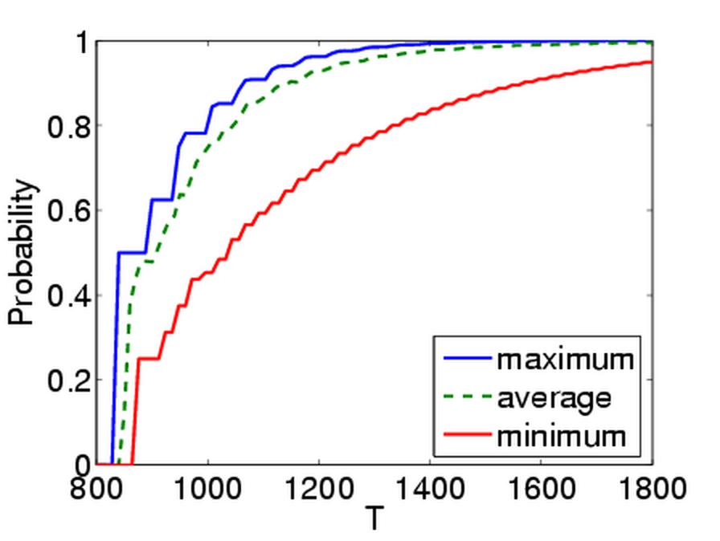
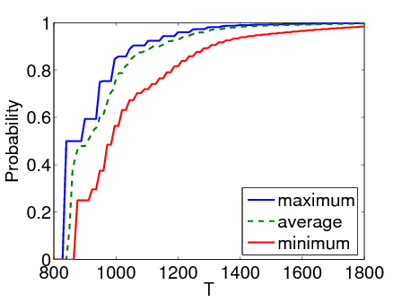
Quantitative properties
For PCTL properties with P as the outermost operator
  PRISM allows a quantitative form
  for MDPs, there are two types: P_{min=?} [ ψ ] and P_{max=?} [ ψ ]
  i.e. “what is the minimum/maximum probability (over all adversaries) that path formula ψ is true?”
  model checking is no harder since compute the values of p_{min}(s, ψ) or p_{max}(s, ψ) anyway
  useful to spot patterns/trends
Example CSMA/CD protocol
  “min/max probability
  that a message is sent
  within the deadline”
DP/Probabilistic Model Checking, Michaelmas 2011

Slide 11
Some real PCTL examples
Byzantine agreement protocol
  P_{min=?} [ F (agreement ∧ rounds≤2) ]
  “what is the minimum probability that agreement is reached within two rounds?”
CSMA/CD communication protocol
  P_{max=?} [ F collisions=k ]
  “what is the maximum probability of k collisions?”
Self-stabilisation protocols
  P_{min=?} [ F^{≤k} stable ]
  “what is the minimum probability of reaching a stable state within k steps?”
DP/Probabilistic Model Checking, Michaelmas 2011

Slide 12
PCTL model checking for MDPs
Algorithm for PCTL model checking [BdA95]
  inputs: MDP M=(S,s_{init},Steps,L), PCTL formula φ
  output: Sat(φ) = { s ∈ S | s ⊨ φ } = set of states satisfying φ
Often, also consider quantitative results
  e.g. compute result of P_{min=?} [ F^{≤k} stable ] for 0≤k≤100
Basic algorithm same as PCTL for DTMCs
  proceeds by induction on parse tree of φ
For the non-probabilistic operators:
  Sat(true) = S
  Sat(a) = { s ∈ S | a ∈ L(s) }
  Sat(¬φ) = S \ Sat(φ)
  Sat(φ₁ ∧ φ₂) = Sat(φ₁) ∩ Sat(φ₂)
DP/Probabilistic Model Checking, Michaelmas 2011

Slide 13
PCTL model checking for MDPs
Main task: model checking P_{~p} [ ψ ] formulae
  reduces to computation of min/max probabilities
  i.e. p_{min}(s, ψ) or p_{max} (s, ψ) for all s ∈ S
  dependent on whether ~ ∈ {≥,>} or ~ ∈ {<,≤}
Three cases:
  next (X φ)
  bounded until (φ₁ U^{≤k} φ₂)
  unbounded until (φ₁ U φ₂)
DP/Probabilistic Model Checking, Michaelmas 2011

Slide 14
PCTL next for MDPs
Computation of probabilities for PCTL next operator
Consider case of minimum probabilities…
  Sat(P_{~p}[ X φ ]) = { s ∈ S | p_{min}(s, X φ) ~ p }
  need to compute p_{min}(s, X φ) for all s ∈ S
Recall in the DTMC case
  sum outgoing probabilities for
  transitions to φ-states
  Prob(s, X φ) = Σ_{s’∈Sat(φ)} P(s,s’)
For MDPs, perform computation for each distribution available in s and then take minimum:
  p_{min}(s, X φ) = min { Σ_{s’∈Sat(φ)} μ(s’) | (a,μ)∈Steps(s) }
Maximum probabilities case is analogous
s
φ
DP/Probabilistic Model Checking, Michaelmas 2011

Slide 15
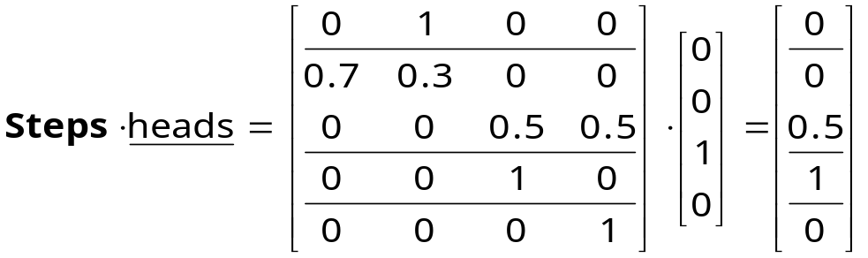
PCTL next - Example
Model check: P_{≥0.5} [ X heads ]
  lower probability bound so minimum probabilities required
  Sat (heads)= {s₂}
  e.g. p_{min}(s₁, X heads) = min (0, 0.5) = 0
  can do all at once with matrix-vector multiplication:
Extracting the minimum for each state yields
  p_{min}(X heads) = [0, 0, 1, 0]
  Sat(P_{≥0.5} [ X heads ]) = {s₂}
{heads}
{init}
s₂
a
1
0.5
a
1
s₀
s₁
c
1
0.7
s₃
a
b
0.5
0.3
{tails}
DP/Probabilistic Model Checking, Michaelmas 2011

Slide 16
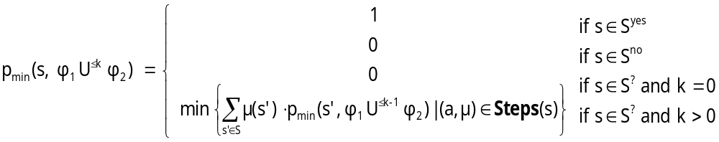
PCTL bounded until for MDPs
Computation of probabilities for PCTL U^{≤k} operator
Consider case of minimum probabilities…
  Sat(P_{~p}[ φ₁ U^{≤k} φ₂ ]) = { s ∈ S | p_{min}(s, φ₁ U^{≤k} φ₂) ~ p }
  need to compute p_{min}(s, φ₁ U^{≤k} φ₂) for all s ∈ S
First identify (some) states where probability is 1 or 0
  S^{yes} = Sat(φ₂) and S^{no} = S \ (Sat(φ₁) ∪ Sat(φ₂))
Then solve the recursive equations:
Maximum probabilities case is analogous
DP/Probabilistic Model Checking, Michaelmas 2011

Slide 17
PCTL bounded until for MDPs
Simultaneous computation of vector p_{min}(φ₁ U^{≤k} φ₂)
  i.e. probabilities p_{min}(s, φ₁ U^{≤k} φ₂) for all s ∈ S
Recursive definition in terms of matrices and vectors
  similar to DTMC case
  requires k matrix-vector multiplications
  in addition requires k minimum operations
DP/Probabilistic Model Checking, Michaelmas 2011

Slide 18
PCTL bounded until - Example
Model check: P_{<0.95} [ F^{≤3} init ] ≡ P_{<0.95} [ true U^{≤3} init ]
  upper probability bound so maximum probabilities required
  Sat (true) = S and Sat (init) = {s₀}
  S^{yes} = {s₀} and S^{no} = ∅
  S? = {s₁,s₂,s₃}
The vector of probabilities is
computed successively as:
  p_{max}(true U^{≤0} init ) = [ 1, 0, 0, 0 ]
  p_{max}(true U^{≤1} init ) = [ 1, 0.7, 0, 0 ]
  p_{max}(true U^{≤2} init ) = [ 1, 0.91, 0, 0 ]
  p_{max}(true U^{≤3} init ) = [ 1, 0.973, 0, 0 ]
Hence, the result is:
  Sat(P_{<0.95} [ F^{≤3} init ]) = { s₂, s₃ }
{heads}
{init}
s₂
a
1
0.5
a
1
s₀
s₁
c
1
0.7
s₃
a
b
0.5
0.3
{tails}
DP/Probabilistic Model Checking, Michaelmas 2011

Slide 19
PCTL until for MDPs
Computation of probabilities for all s ∈ S:
  p_{min}(s, φ₁ U φ₂) or p_{max}(s, φ₁ U φ₂)
Essentially the same as computation of reachability probabilities (see previous lecture)
  just need to consider additional φ₁ constraint
Overview:
  precomputation:
    identify states where the probability is 0 (or 1)
  several options to compute remaining values:
    value iteration
    reduction to linear programming
DP/Probabilistic Model Checking, Michaelmas 2011

Slide 20
PCTL until for MDPs - Precomputation
Determine all states for which probability is 0
  min case: S^{no} = { s∈S | p_{min}(s, φ₁ U φ₂)=0 } - Prob0E
  max case: S^{no} = { s∈S | p_{max}(s, φ₁ U φ₂)=0 } - Prob0A
Determine all states for which probability is 1
  min case: S^{yes} = { s∈S | p_{min}(s, φ₁ U φ₂)=1 } - Prob1A
  max case: S^{yes} = { s∈S | p_{max}(s, φ₁ U φ₂)=1 } - Prob1E
Like for DTMCs:
  identifying 0 states required (for uniqueness of LP problem)
  identifying 1 states is optional (but useful optimisation)
Advantages of precomputation
  reduces size of numerical computation problem
  gives exact results for the states in S^{yes} and S^{no} (no round-off)
  suffices for model checking of qualitative properties
not
covered here
DP/Probabilistic Model Checking, Michaelmas 2011

Slide 21
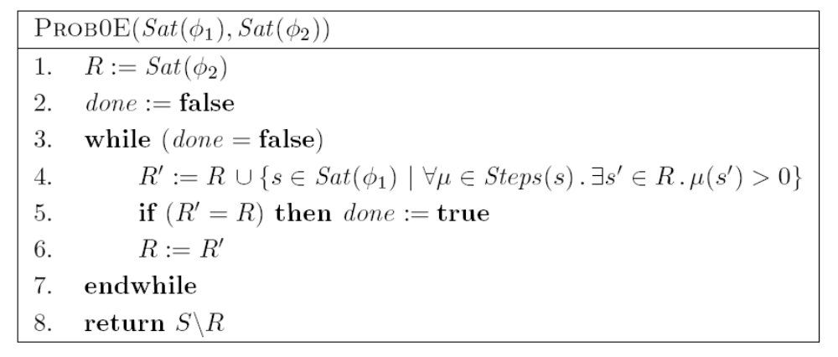
PCTL until for MDPs - Prob0E
Minimum probabilities 0
  S^{no} = { s∈S | p_{min}(s, φ₁ U φ₂)=0 } = Sat(¬P_{>0} [ φ₁ U φ₂ ])
DP/Probabilistic Model Checking, Michaelmas 2011

Slide 22
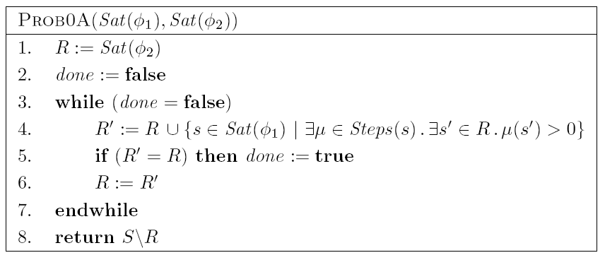
PCTL until for MDPs - Prob0A
Maximum probabilities 0
  S^{no} = { s∈S | p_{max}(s, φ₁ U φ₂)=0 }
DP/Probabilistic Model Checking, Michaelmas 2011

Slide 23
PCTL until for MDPs - Prob1E
Maximum probabilities 1
  S^{yes} = { s∈S | p_{max}(s, φ₁ U φ₂)=1 } = Sat(¬P_{<1} [ φ₁ U φ₂ ])
Prob1E algorithm (see next slide)
  two nested loops (double fixed point)
  result, stored in R, will be S^{yes}; initially R is S
  iteratively remove (some) states u with p_{max}(u, φ₁ U φ₂)<1
    i.e. remove (some) states for which,
    under no adversary σ, is Prob^{σ}(s, φ₁ U φ₂)=1
  done by inner loop which computes subset R’ of R
    R’ contains φ₁-states with a probability distribution for which all transitions stay within R and at least one eventually reaches φ₂
  note: after first iteration, R contains:
    { s | Prob^{A}(s, φ₁ U φ₂)>0 for some A }
    essentially: execution of Prob0A and removal of S^{no} from R
DP/Probabilistic Model Checking, Michaelmas 2011

Slide 24
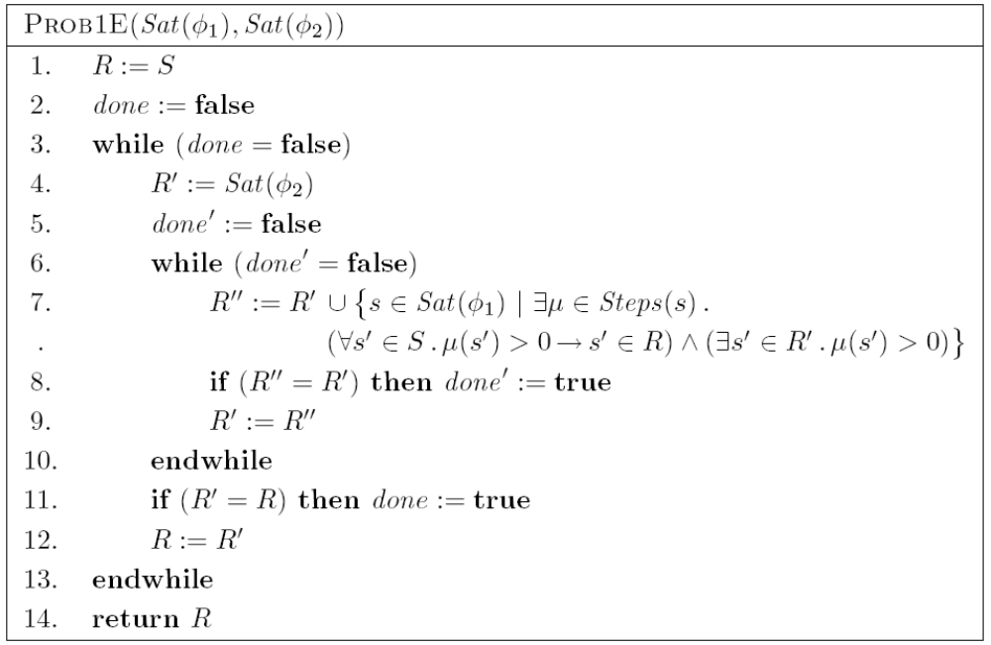
PCTL until for MDPs - Prob1E
DP/Probabilistic Model Checking, Michaelmas 2011

Slide 25
Prob1E - Example
S^{yes} = { s∈S | p_{max}(s, ¬a U b)=1 }
R = { 0, 1, 2, 3, 4 ,5 6 }
  R’ = {2} ; R’ = {1, 2, 5} ; R’ = {1, 2, 4, 5} ; R’ = {1, 2, 4, 5, 6}
R = { 1, 2, 4, 5, 6 }
  R’ = {2} ; R’ = {1, 2, 5}
R = { 1, 2, 5 }
  R’ = {2} ; R’ = {1, 2, 5}
R = { 1, 2, 5 }
S^{yes} = { 1, 2, 5 }
{b}
{a}
0
1
2
3
4
5
6
DP/Probabilistic Model Checking, Michaelmas 2011

Slide 26
PCTL until for MDPs - Prob1A
Minimum probabilities 1
  S^{yes} = { s∈S | p_{min}(s, φ₁ U φ₂)=1 }
Can also be done with a graph-based algorithm
Details omitted here
For minimum probabilities, just take S^{yes} = Sat(φ₂)
  recall that computing states for which probability=1 is just an optimisation: it is not required for correctness
DP/Probabilistic Model Checking, Michaelmas 2011

Slide 27
PCTL until for MDPs
Min/max probabilities for the remaining states, i.e.
S? = S \ ( S^{yes} ∪ S^{no} ), can be computed using either…
1. Value iteration
  approximate iterative solution method
  preferable in practice for efficiency reasons
2. Reduction to a linear optimisation problem
  solve with well-known linear programming (LP) techniques
    Simplex, ellipsoid method, interior point method
  yields exact solution in finite number of steps
NB: Policy iteration also possible but not considered here
DP/Probabilistic Model Checking, Michaelmas 2011

Slide 28
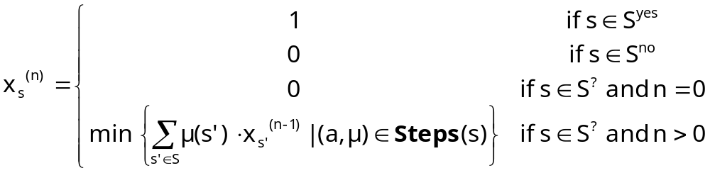
Method 1 - Value iteration (min)
Minimum probabilities satisfy:
  p_{min}(s, φ₁ U φ₂) = lim_{n→∞} x_{s}^{(n)} where:
Approximate iterative solution:
  compute vector x^{(n)} for “sufficiently large” n
  in practice: terminate iterations when some pre-determined convergence criteria satisfied
  e.g. max_{s} | x^{(n)}(s) - x^{(n-1)}(s)) | < ɛ for some tolerance ɛ
DP/Probabilistic Model Checking, Michaelmas 2011

Slide 29
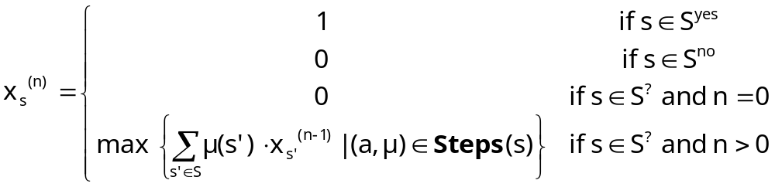
Method 1 - Value iteration (max)
Similarly, maximum probabilities satisfy:
  p_{max}(s, φ₁ U φ₂) = lim_{n→∞} x_{s}^{(n)} where:
…and can be approximated iteratively
DP/Probabilistic Model Checking, Michaelmas 2011

Slide 30
PCTL until - Example
Model check: P_{>0.5} [ F a ] ≡ P_{>0.5} [ true U a ]
  lower probability bound so minimum probabilities required
0.5
{a}
s₁
0.4
s₂
1
0.1
1
1
0.5
1
s₀
s₃
0.25
0.25
DP/Probabilistic Model Checking, Michaelmas 2011

Slide 31
PCTL until - Example
Model check: P_{>0.5} [ F a ] ≡ P_{>0.5} [ true U a ]
  lower probability bound so minimum probabilities required
0.5
{a}
S^{yes} = Sat(a)
s₁
0.4
s₂
1
0.1
1
1
Prob0E
0.5
1
s₀
s₃
0.25
0.25
S^{no} = { s∈S | p_{min}(s, F a)=0 }
DP/Probabilistic Model Checking, Michaelmas 2011

Slide 32
PCTL until - Example
Compute: p_{min}(s_{i}, F a)
S^{yes} = {s₂}, S^{no} ={s₃}, S? = {s₀, s₁}
[ x₀^{(n)},x₁^{(n)},x₂^{(n)},x₃^{(n)} ]
n=0: [ 0, 0, 1, 0 ]
n=1: [ min(1⋅0, 0.25⋅0+0.25⋅0+0.5⋅1),
0.1⋅0+0.5⋅0+0.4⋅1, 1, 0 ]
= [ 0, 0.4, 1, 0 ]
n=2: [ min(1⋅0.4,0.25⋅0+0.25⋅0+0.5⋅1),
0.1⋅0+0.5⋅0.4+0.4⋅1, 1, 0 ]
=[ 0.4, 0.6, 1, 0 ]
n=3: …
0.5
{a}
S^{yes}
s₁
0.4
s₂
1
0.1
1
1
0.5
1
s₀
s₃
0.25
0.25
S^{no}
DP/Probabilistic Model Checking, Michaelmas 2011

Slide 33
PCTL until - Example
[ x₀^{(n)},x₁^{(n)},x₂^{(n)},x₃^{(n)} ]
n=0: [ 0.000000, 0.000000, 1, 0 ]
n=1: [ 0.000000, 0.400000, 1, 0 ]
n=2: [ 0.400000, 0.600000, 1, 0 ]
n=3: [ 0.600000, 0.740000, 1, 0 ]
n=4: [ 0.650000, 0.830000, 1, 0 ]
n=5: [ 0.662500, 0.880000, 1, 0 ]
n=6: [ 0.665625, 0.906250, 1, 0 ]
n=7: [ 0.666406, 0.919688, 1, 0 ]
n=8: [ 0.666602, 0.926484, 1, 0 ]
…
n=20: [ 0.666667, 0.933332, 1, 0 ]
n=21: [ 0.666667, 0.933332, 1, 0 ]
≈ [ 2/3, 14/15, 1, 0 ]
0.5
{a}
S^{yes}
s₁
0.4
s₂
1
0.1
1
1
0.5
1
s₀
s₃
0.25
0.25
S^{no}
p_{min}(F a) =
[ 2/3, 14/15, 1, 0 ]
Sat(P_{>0.5} [F a]) = { s₀, s₁, s₂ }
DP/Probabilistic Model Checking, Michaelmas 2011

Slide 34
Example - Optimal adversary
Like for reachability, can generate an optimal memoryless adversary using min/max probability values
  and thus also a DTMC
Min adversary σ_{min}
[ x₀^{(n)},x₁^{(n)},x₂^{(n)},x₃^{(n)} ]
…
n=20: [ 0.666667, 0.933332, 1, 0 ]
n=21: [ 0.666667, 0.933332, 1, 0 ]
≈ [ 2/3, 14/15, 1, 0 ]
s₀ : min(1⋅14/15, 0.5⋅1+0.5⋅0+0.25⋅2/3)
=min(14/15, 2/3)
0.5
{a}
S^{yes}
s₁
0.4
s₂
1
0.1
1
1
0.5
1
s₀
s₃
0.25
0.25
S^{no}
DP/Probabilistic Model Checking, Michaelmas 2011

Slide 35
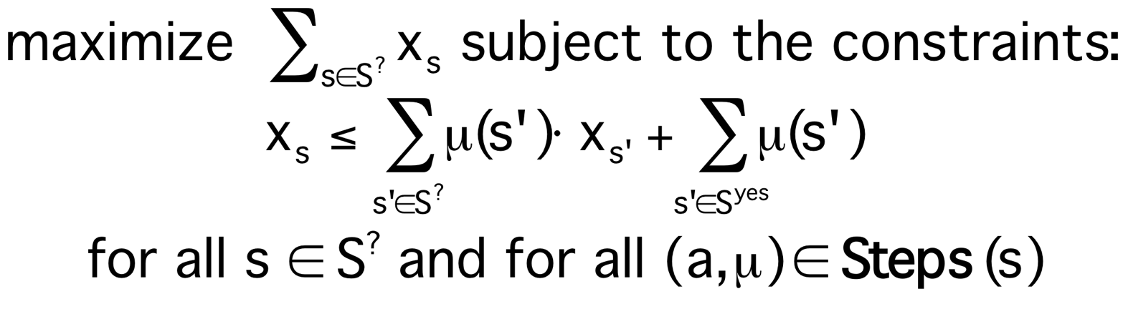
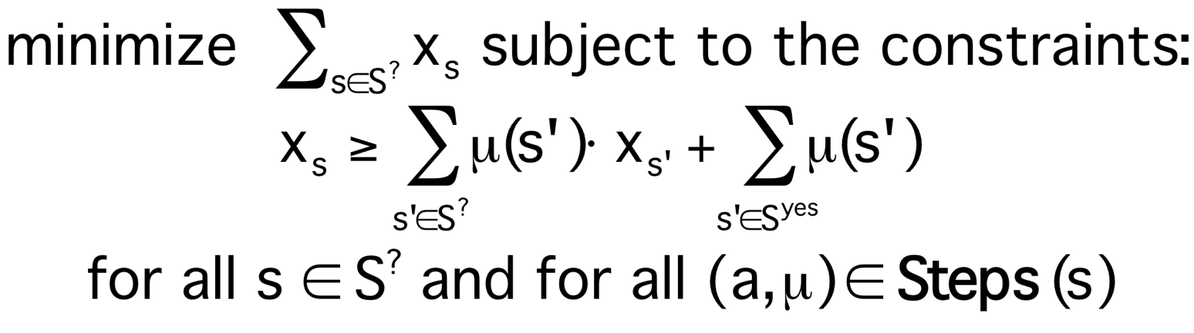
Method 2 - Linear optimisation problem
Probabilities for states in S? = S \ (S^{yes} ∪ S^{no}) can also be obtained from a linear optimisation problem
Minimum probabilities:
Maximum probabilities:
DP/Probabilistic Model Checking, Michaelmas 2011

Slide 36
PCTL until - Example
0.5
{a}
S^{yes}
Let x_{i} = p_{min}(s_{i}, F a)
S^{yes}: x₂=1, S^{no}: x₃=0
For S? = {s₀, s₁} :
Maximise x₀+x₁ subject to constraints:
  x₀ ≤ x₁
  x₀ ≤ 0.25⋅x₀ + 0.5
  x₁ ≤ 0.1⋅x₀ + 0.5⋅x₁ + 0.4
s₁
0.4
s₂
1
0.1
1
1
0.5
1
s₀
s₃
0.25
0.25
S^{no}
DP/Probabilistic Model Checking, Michaelmas 2011

Slide 37
PCTL until - Example
0.5
{a}
S^{yes}
Let x_{i} = p_{min}(s_{i}, F a)
S^{yes}: x₂=1, S^{no}: x₃=0
For S? = {s₀, s₁} :
Maximise x₀+x₁ subject to constraints:
  x₀ ≤ x₁
  x₀ ≤ 2/3
  x₁ ≤ 0.2⋅x₀ + 0.8
s₁
0.4
s₂
1
0.1
1
1
0.5
1
s₀
s₃
0.25
0.25
S^{no}
x₁
x₁
x₁
1
1
1
x₀ ≤ x₁
0.8
x₀ ≤ 2/3
  x₁ ≤ 0.2⋅x₀
  + 0.8
0
x₀
0
x₀
0
x₀
0
1
0
2/3
1
0
1
DP/Probabilistic Model Checking, Michaelmas 2011

Slide 38
PCTL until - Example
0.5
{a}
S^{yes}
Let x_{i} = p_{min}(s_{i}, F a)
S^{yes}: x₂=1, S^{no}: x₃=0
For S? = {s₀, s₁} :
Maximise x₀+x₁ subject to constraints:
  x₀ ≤ x₁
  x₀ ≤ 2/3
  x₁ ≤ 0.2⋅x₀ + 0.8
s₁
0.4
s₂
1
0.1
1
1
0.5
1
s₀
s₃
0.25
0.25
S^{no}
x₁
1
p_{min}(F a) =
[ 2/3, 14/15, 1, 0 ]
Sat(P_{>0.5} [F a]) =
{ s₀, s₁, s₂ }
  Solution:
  (x₀, x₁)
  =
  (2/3, 14/15)
0.8
max
0
x₀
0
2/3
1
DP/Probabilistic Model Checking, Michaelmas 2011

Slide 39
Example - Optimal adversary
0.5
{a}
S^{yes}
Get optimal adversary from constraints of
optimisation problem that yield solution
Alternatively, use optimal probability
values in value iteration function, as
shown in value iteration example
s₁
0.4
s₂
1
0.1
1
1
0.5
1
s₀
s₃
0.25
0.25
S^{no}
x₁
1
0.8
  x₁ = 0.2⋅x₀ + 0.8
  x₀ = x₁
  x₀ = 2/3
max
Two memoryless
adversaries
0
x₀
0
2/3
1
DP/Probabilistic Model Checking, Michaelmas 2011

Slide 40
PCTL until - Example 2
Model check: P_{<0.1} [ F a ]
  upper probability bound so maximum probabilities required
0.5
{a}
s₁
0.4
s₂
1
0.1
1
1
0.5
1
s₀
s₃
0.25
0.25
DP/Probabilistic Model Checking, Michaelmas 2011

Slide 41
PCTL until - Example 2
Model check: P_{<0.1} [ F a ]
  upper probability bound so maximum probabilities required
p_{max}(F a) = [ 1, 1, 1, 1 ] and Sat(P_{<0.1} [ F a ]) = ∅
0.5
{a}
S^{yes} = { s∈S | p_{min}(s, F a)=1 } = S
s₁
0.4
s₂
1
Prob1E
0.1
1
1
0.5
1
Prob0A
s₀
s₃
0.25
0.25
S^{no} = { s∈S | p_{min}(s, F a)=0 } = ∅
DP/Probabilistic Model Checking, Michaelmas 2011

Slide 42
PCTL until - Example 3
Model check: P_{>0} [ F a ]
  lower probability bound so minimum probabilities required
  qualitative property so numerical computation can be avoided
p_{min}(F a) = [ ?, ?, ?, 0 ] and Sat(P_{>0} [ F a ]) = {s₀,s₁,s₂}
0.5
{a}
s₁
0.4
s₂
S^{no} = { s∈S | p_{min}(s, F a)=0 }
Prob0E yields S^{no} = {s₃}
1
0.1
1
1
0.5
1
s₀
s₃
0.25
0.25
S^{no}
DP/Probabilistic Model Checking, Michaelmas 2011

Slide 43
Costs and rewards
We can augment MDPs with rewards (or costs)
  real-valued quantities assigned to states and/or actions
  different from the DTMC case where transition rewards assigned to individual transitions
For a MDP (S,s_{init},Steps,L), a reward structure is a pair (ρ,ι)
  ρ : S → ℝ_{≥0} is the state reward function
  ι : S × Act → ℝ_{≥0} is transition reward function
As for DTMCs these can be used to compute:
  elapsed time, power consumption, size of message queue, number of messages successfully delivered, net profit, …
DP/Probabilistic Model Checking, Michaelmas 2011

Slide 44
PCTL and rewards
Augment PCTL with rewards based properties
  allow a wide range of quantitative measures of the system
  basic notion: expected value of rewards
φ ::= … | R_{~r} [ I^{=k} ] | R_{~r} [ C^{≤k} ] | R_{~r} [ F φ ]
  where r ∈ ℝ_{≥0}, ~ ∈ {<,>,≤,≥}, k ∈ ℕ
R_{~r} [ ⋅ ] means “the expected value of ⋅ satisfies ~r for all adversaries”
expected reward is ~r
“instantaneous”
“cumulative”
“reachability”
DP/Probabilistic Model Checking, Michaelmas 2011

Slide 45
Types of reward formulas
Instantaneous: R_{~r} [ I^{=k} ]
  the expected value of the reward at time-step k is ~r for all adversaries
  “the minimum expected queue size after exactly 90 seconds”
Cumulative: R_{~r} [ C^{≤k} ]
  the expected reward cumulated up to time-step k is ~r for all adversaries
  “the maximum expected power consumption over one hour”
Reachability: R_{~r} [ F φ ]
  the expected reward cumulated before reaching a state satisfying φ is ~r for all adversaries
  the maximum expected time for the algorithm to terminate
DP/Probabilistic Model Checking, Michaelmas 2011

Slide 46
Reward formula semantics
Formal semantics of the three reward operators:
  for a state s in the MDP:
  s ⊨ R_{~r} [ I^{=k} ] ⇔ Exp^{σ}(s, X_{I=k}) ~ r for all adversaries σ
  s ⊨ R_{~r} [ C^{≤k} ] ⇔ Exp^{σ}(s, X_{C≤k}) ~ r for all adversaries σ
  s ⊨ R_{~r} [ F Φ ] ⇔ Exp^{σ}(s, X_{FΦ}) ~ r for all adversaries σ
  Exp^{σ}(s, X) denotes the expectation of the random variable
  X : Path^{σ}(s) → ℝ_{≥0} with respect to the probability measure Pr^{σ}_{s}
DP/Probabilistic Model Checking, Michaelmas 2011

Slide 47

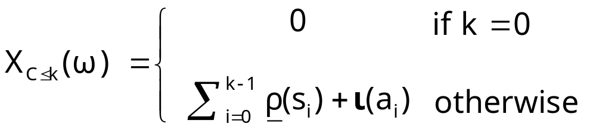
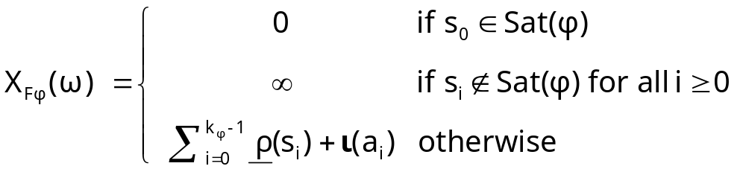
Reward formula semantics
For an infinite path ω= s₀(a₀,μ₀)s₁(a₁,μ₁)s₂…
where k_{φ} =min{ i | s_{i} ⊨ φ }
DP/Probabilistic Model Checking, Michaelmas 2011

Slide 48
Model checking reward formulas
Instantaneous: R_{~r} [ I^{=k} ]
  similar to the computation of bounded until probabilities
  solution of recursive equations
  k matrix-vector multiplications (+ min/max)
Cumulative: R_{~r} [ C^{≤k} ]
  extension of bounded until computation
  solution of recursive equations
  k iterations of matrix-vector multiplication + summation
Reachability: R_{~r} [ F φ ]
  similar to the case for until
  solve a linear optimization problem (or value iteration)
DP/Probabilistic Model Checking, Michaelmas 2011

Slide 49
Model checking complexity
For model checking of an MDP (S,s_{init},Steps,L) and PCTL formula φ (including reward operators)
  complexity is linear in |Φ| and polynomial in |S|
Size |φ| of φ is defined as number of logical connectives and temporal operators plus sizes of temporal operators
  model checking is performed for each operator
Worst-case operators are P_{~p} [ φ₁ U φ₂ ] and R_{~r} [ F φ ]
  main task: solution of linear optimization problem of size |S|
  can be solved with ellipsoid method (polynomial in |S|)
  and also precomputation algorithms (max |S| steps)
DP/Probabilistic Model Checking, Michaelmas 2011

Slide 50
Summing up…
PCTL for MDPs
  same as syntax as for PCTL
  key difference in semantics: “for all adversaries”
  requires computation of minimum/maximum probabilities
PCTL model checking for MDPs
  same basic algorithm as for DTMCs
  next: matrix-vector multiplication + min/max
  bounded until: k matrix-vector multiplications + min/max
  until : precomputation algorithms + numerical computation
    precomputation: Prob0A and Prob1E for max, Prob0E for min
    numerical computation: value iteration, linear optimisation
  complexity linear in |Φ| and polynomial in |S|
Costs and rewards
DP/Probabilistic Model Checking, Michaelmas 2011

